Slide 1

Unit-01 Introduction to Data Structure & Array
Data Structure (DS)
DU #2304CS411
Prof. Vijay M Shekhat
Department of Computer Science & Engineering
vijay.shekhat@darshan.ac.in
9558045778

Slide 2

Looping
Outline
What is Data?
What is Data Management?
What is Data Structure?
Classification of Data Structure
Operations of Data Structure
Algorithm
Time and Space Complexity
Worst-Best-Average Case Time Complexity
Time-Space Trade-off
Why We Need Arrays?
Introduction to Array
Declaration of an Array
Accessing the element of an Array
Calculating the Address of Array Elements
Calculating the Length of an Array
Operations on Arrays

Slide 3

What is Data?
Data is the basic fact or entity that is utilized in calculation or manipulation.
There are two different types of data Numeric data and Alphanumeric data.
When a programmer collects such type of data for processing, he would require space to store them in computer’s main memory.
The process of storing data items in computer’s main memory is called representation.
Data to be processed must be organized in a particular fashion, these organization leads to structuring of data, and hence the mission to study the Data Structures.

Slide 4
What is Data Management?
To solve any problem one should develop an efficient program.
A program is said to be efficient if it executes in minimum time and with minimum memory space.
In order to write efficient programs we need to apply some data management concepts.
The concept of data management is a complex task that includes activities like data collection, organization of data into appropriate structures, developing and maintaining routine for quality assurance.
Data structures are used in almost every program or software system.

Slide 5

What is Data Structure?
Data Structure is basically a group of data elements that are put together under one name, and which defines a particular way of storing and organizing data in a computer so that it can be used efficiently.
Data Structure is a representation of the logical relationship existing between individual elements of data.
In other words, a Data Structure is a way of organizing all data items that considers not only the elements stored but also their relationship to each other.
We can also define Data Structure as a mathematical or logical model of a particular organization of data items.
Data Structures are used in almost every program.
Some common examples of Data Structures are Array, Stack, Queue, Linked List, Tree, Graph, Hash Tables, etc..

Slide 6
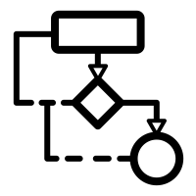

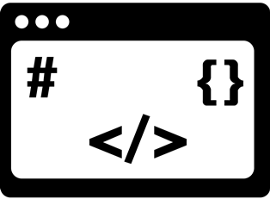
Cont...
The representation of a particular data structure in the memory of a computer is called Storage Structure.
Data structures with same type of elements are called Homogeneous Data Structure. Example: Array, Stack.
Data structures with different type of elements are called Non-Homogeneous Data Structure. Example: Structure, Class.
Algorithm
Data Structure
Program

Slide 7
Classification of Data Structure
Data Structure
Primitive Data Structure
Non-Primitive Data Structure
Integer
Characters
Arrays
Lists
Files
Floating
Point
Pointers
Linear List
Non-linear List
Stack
Queue
Graphs
Trees

Slide 8
Primitive / Non-Primitive Data Structures
Primitive data structures
Primitive Data Structures are the fundamental data types which are supported by a programming languages.
Integer, float, character and pointer are examples of primitive data structures.
Non Primitive data structure
Non Primitive Data Structures are created using primitive data structures.
The Non-Primitive Data Structures emphasize on structuring of a group of homogeneous or heterogeneous data items.
Examples of Non-primitive data type are Array, List, and File.
Lists can further be classified into two categories: Linear and Non-Linear Data Structures.

Slide 9
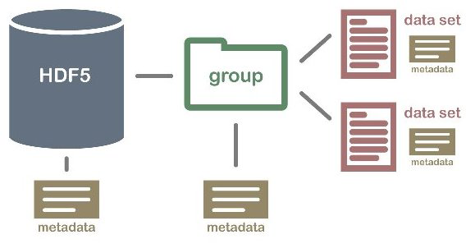
Non primitive Data Structure
Array: An array is a fixed-size sequenced collection of elements of the same data type.
List: An ordered set containing variable number of elements is called as Lists.
File: A file is a collection of logically related information. It can be viewed as a large list of records consisting of various fields.
Array
File
List

Slide 10
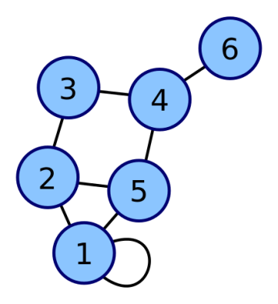
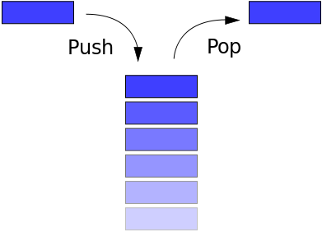
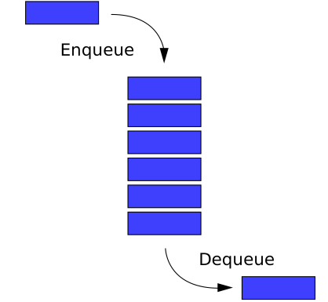
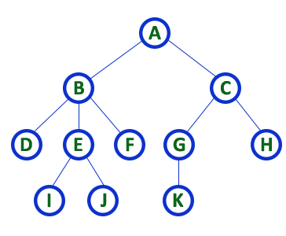
Linear/Non-Linear Data Structure
Linear Data Structure
If the elements of a Data Structure are stored in a linear or sequential order, then it is a Linear Data Structure.
Examples of Linear Data Structure are Array, Linked List, Stack and Queue.
Nonlinear data structures
If the elements of a Data Structure are not stored in a sequential order, then it is a Non-Linear Data Structure.
Examples of Non-linear Data Structure are Tree and Graph.
Stack
Queue
Tree
Graph

Slide 11
Operations of Data Structure
Insertion: It is used to add new data items to the given list of data items.
Deletion: It means to remove/delete a particular data item from the given collection of data items.
Traversal: It means to access each data item exactly once so that it can be processed.
Update: It updates or modifies the data in the Data Structure.
Search: It is used to find the location of one or more data items that satisfy the given constraint.
Sort: Data items can be arranged in some order like ascending or descending order depending on the type of application.
Merge: Lists of two sorted data items can be combined to form a single list of sorted data items.

Slide 12
Algorithm
The typical definition of algorithm is “a formally defined procedure for performing some calculation”.
If a procedure is formally defined, then it can be implemented using a formal language, and such a language is known as programming language.
In general terms, an algorithm provides a blueprint to write program to solve a particular problem.
It is considered to be an effective procedure for solving a problem in finite number of steps.
A well defined algorithm always provides an answer and is guaranteed to terminate.
It is possible to have more than one algorithm to solve any problem.
One can choose from those multiple algorithms, which can be implemented in least time and space.

Slide 13
Time and Space Complexity
Analysing an algorithm means determining the amount of resources (such as time and memory) needed to execute it.
Time complexity of an algorithm is basically the running time of a program as a function of the input size.
Space complexity of an algorithm is the amount of computer memory that is required during the program execution as a function of the input size.
However running time requirements are more critical than memory requirements. Therefore we will concentrate on the running time efficiency of algorithms.

Slide 14
Worst-Best-Average Case Time Complexity
Worst-case (‘Ω’ - Omega Notation) running time :
In the worst case analysis, we calculate the upper bound on the running time for any input of the algorithm.
We must know the case that causes a maximum number of operations to be executed.
For Linear search, the worst case happens when the element to be searched is not present in the array.
Best-case (‘O’ - Big-O Notation) running time :
In the best case analysis, we calculate the lower bound on the running time of an algorithm.
We must know the case that causes a minimum number of operations to be executed.
For Linear search, the best case happens when the element to be searched is present at the first location of the array.
Average-case (‘Ɵ’ - Theta Notation) running time :
In average case analysis, we take all possible inputs and calculate the computing time for all the inputs.
Sum all the calculated values and divide the sum by the total number of inputs.
For Linear search, average case happens when the element to searched is present some where in between the array.

Slide 15
Time-Space Trade-off
The best algorithm to solve a particular problem is the one that requires less memory space and takes less time to complete its execution.
There can be more than one algorithm to solve a particular problem. One may require less memory space, while the other may require less CPU time to execute.
Thus, it is not uncommon to sacrifice one thing for the other.
Hence, there exists a time–space trade-off among algorithms.
So, if space is a big constraint, then one might choose a program that takes less space at the cost of more CPU time.
On the contrary, if time is a major constraint, then one might choose a program that takes minimum time to execute at the cost of more space.

Slide 16
Why We Need Arrays?
Consider a situation in which we have 20 students in a class and we have been asked to write a program that reads and prints the marks of all the 20 students. In this program, we will need 20 integer variables with different names.
Now to read the values of these 20 variables, we must have 20 read statements. Similarly, to print the value of these variables, we need 20 write statements. Would it be possible to follow this approach if we have to read and print the marks of students,
in the entire course (say 100 students)
in the entire college (say 500 students)
in the entire university (say 10,000 students)
The answer is no, definitely not! To process a large amount of data, we need a data structure known as Array.

Slide 17
Introduction to Array
An Array is a collection of similar data elements.
These data elements have the same data type.
The elements of the array are stored in consecutive memory locations and are referenced by an index (also known as the subscript).
The index is an ordinal number which is used to identify an element of the array.
Types of Array:
One-dimensional array
Two-dimensional array
Multi-dimensional array

Slide 18
Declaration of an Array
An array must be declared before being used.
Declaring an array means specifying the following:
Data type: the kind of values it can store. For example, int, char, float, double, etc..
Name: to identify the array.
Size: the maximum number of elements that the array can hold.
Arrays are declared using following syntax:
Data-type Name[Size];
Example: int a[10];

Slide 19
Accessing the element of an Array
To access all the elements of an array, we must use a loop.
We can access all the elements of an array by varying the value of the subscript into the array.
But note that the subscript must be an integer value.
marks[]
// set each element of the array to -1
int i, marks[5];
for(i=0;i<5;i++)
marks[i] = -1;
Index i: | 0 | 1 | 2 | 3 | 4
Value: | -1 | -1 | -1 | -1 | -1
 | marks[0] | marks[1] | marks[2] | marks[3] | marks[4]

Slide 20
Calculating the Address of Array Elements
We may wonder how C gets to know where an individual element of an array is located in the memory.
The array name actually references to the address of the first byte of the array.
When we use the array name, we are actually referring to the first byte of the array.
The subscript/index represents the offset from the beginning of the array to the element being referenced.
That means, with just the array name and the index, C can calculate the address of any element in the array.
Since array stores all the elements in the consecutive memory locations, storing just the base address(address of the first element in the array) is sufficient.

Slide 21
Cont…
The address of other data elements can be calculated using the base address.
The formula to perform the calculation:
Address of data element,
A is the array
k is the index of the element of which we want to calculate the address
BA is the base address of the array A
w is the size of one element in the memory (in bytes)
A[k] = BA(A) + w(k – LowerBound)
Data Type | Size
int | 2 bytes
float | 4 bytes
double | 8 bytes
char | 1 bytes

Slide 22
EXAMPLE : Calculating the Address of Array Elements
Given an array int marks[] = {99, 67, 78, 56, 88, 90, 34, 85}, calculate the address of marks[4], if the base address is 1000.
k = 4
BA(A) = 1000
Storing an integer value requires 2 bytes. So w=2.
Lower bound = 0
Formula:
A[k] = BA(A) + w(k – LowerBound)
marks[4] = 1000 + 2 (4-0)
= 1000 + 8
= 1008

Slide 23
Calculating the Length of an Array
The length of an array is given by the number of elements stored in it.
The formula to perform the calculation:
Length of an Array,
UpperBound = index of the last element
LowerBound = index of the first element
Length = (UpperBound– LowerBound) + 1

Slide 24
EXAMPLE : Calculating the Length of an Array
Let Age[5] be an array of integers such that, Age[0] = 2, Age[1] = 5, Age[2] = 3, Age[3] = 1, Age[4] = 7. Show the memory representation of the array and calculate its length.
The memory representation of the array Age[5] is given as follow:
Here,
LowerBound = 0
UpperBound = 4
Length = UpperBound – LowerBound + 1
= 4 – 0 + 1
= 5
2 | 5 | 3 | 1 | 7
Age[0] | Age[1] | Age[2] | Age[3] | Age[4]

Slide 25
Operations on Arrays
There are a number of operations that can be performed on arrays.
These operations include:
Traversing an Array
Inserting an element in an Array
Searching an element in an Array
Deleting an element from an Array
Merging two Arrays
Sorting an Array in either ascending or descending order.
We will see each operation in detail except searching and sorting here in this chapter.

Slide 26
Traversing an Array
Traversing an array means accessing each and every element of the array for a specific purpose (printing every element, counting the total number of elements or performing any process on these elements) exactly once.
1. [INITIALIZATION] Set I = lower_bound
2. Repeat step 3 to 4 while I <= upper_bound
3. Apply process to A[i]
4. Set I = I + 1
[END OF LOOP]
EXIT

Slide 27
Inserting an element at the End of an Array
If an element has to be inserted at the end of an existing array, then the task of insertion is quite simple.
1. Set upper_bound = upper_bound + 1
2. Set A[upper_bound] = VAL
3. EXIT

Slide 28
Inserting an element in the Middle of an Array
If we have to insert an element in the middle of the array, we have to move few elements from their positions in order to accommodate space for the new element.
The algorithm INSERT will be declared as INSERT(A, N, POS, VAL).
The arguments are:
A, is the array in which the element has to be inserted.
N, is the number of elements in the array.
POS, is the position at which the element has to be inserted.
VAL, the value that has to be inserted.

Slide 29
Cont…
Algorithm to insert an element in the middle of an array.
PROCEDURE : INSERT(A, N, POS, VAL)
[INITIALIZATION]
SET I = N
2. Repeat Step 3 and 4 while I >= POS
SET A[I+1] = A[I]
SET I = I – 1
[END OF LOOP]
SET N = N + 1
SET A[POS]=VAL
EXIT

Slide 30
Deleting an element from the End of an Array
If an element has to be deleted from the end of an existing array, then the task of deletion is quite simple.
1. SET upper_bound = upper_bound - 1
2. EXIT

Slide 31
Deleting an element from the Middle of an Array
If we have to delete an element in the middle of the array, we have to move few elements from their positions in order to occupy space of the deleted element.
The algorithm DELETE will be declared as DELETE(A, N, POS).
The arguments are:
A, is the array from which the element has to be deleted.
N, is the number of elements in the array.
POS, is the position from which the element has to be deleted.

Slide 32
Deleting an element from an Array
Algorithm to delete an element from the middle of an array.
PROCEDURE : DELETE(A, N, POS)
[INITIALIZATION]
SET I = POS
2. Repeat Step 3 and 4 while I <= N-1
SET A[I] = A[I+1]
SET I = I + 1
[END OF LOOP]
SET N = N - 1
EXIT

Slide 33
Merging Two Arrays
Merging two arrays in a third array means first copying the content of the first array into third array and then copying the content of second array into the third array.
Hence the merged array contains the content of first array followed by the content of the second array.
If the array are unsorted, then merging the arrays is very simple.
Array 1:
Array 2:
Array 3:
90 | 56 | 89 | 77 | 69
45 | 88 | 76 | 99 | 12 | 58 | 81
90 | 56 | 89 | 77 | 69 | 45 | 88 | 76 | 99 | 12 | 58 | 81

Slide 34
Cont…
If we have two sorted arrays and the resultant merged array also needs to be a sorted one.
Then the task of merging the arrays becomes a little difficult.
Array 1:
Array 2:
Array 3:
20 | 30 | 40 | 50 | 60
15 | 22 | 31 | 45 | 56 | 62 | 78
15 | 20 | 22 | 30 | 31 | 40 | 45 | 50 | 56 | 60 | 62 | 78

Slide 35
Data Structure (DS)
DU #2304CS411
Prof. Vijay M. Shekhat
Department of Computer Science & Engineering
Vijay.shekhat@Darshan.ac.in
9558045778

